Slide 1
Naveen Kumar G au421221104023 Karpaga Vinayaga College of Engineering and Technology
3/21/2024 Annual Review

Slide 2
PROJECT TITLE
Pament
ONLINE PAYMENT FRAUD DETECTION USING
GENERATIVE ADVERSIAL NETWORK (GANs)
3/21/2024 Annual Review

Slide 3


AGENDA
Introduction
Problem Statement
Project Overview
End Users
Solution and Value Proposition
The WOW in Your Solution
Modeling
Results
Conclusion
3/21/2024 Annual Review

Slide 4

PROBLEM STATEMENT
Develop a robust online payment fraud detection system utilizing Generative Adversarial Networks (GANs) to address the growing concern of fraudulent activities in online transactions. The system should effectively distinguish between legitimate and fraudulent transactions in real-time, providing accurate predictions while minimizing false positives to ensure a seamless user experience.
3/21/2024 Annual Review

Slide 5

PROJECT OVERVIEW
Data Collection and Preprocessing:
Gather a diverse dataset of online payment transactions, including both legitimate and fraudulent instances.
Preprocess the data to handle missing values, normalize features, and address class imbalance issues.
Feature Engineering:
Identify relevant features from the transaction data, such as transaction amount, timestamp, location, and user behavior.
Engineer new features or transform existing ones to capture meaningful patterns indicative of fraud.
Real-time Deployment:
Deploy the trained GAN model into the online payment processing platform, enabling real-time fraud detection.
Implement low-latency inference mechanisms to ensure minimal impact on transaction processing speed.
Monitoring and Maintenance:
Develop monitoring tools to track the performance of the fraud detection system in production
3/21/2024 Annual Review

Slide 6

WHO ARE THE END USERS?
Financial Institutions:
Banks, credit card companies, and other financial institutions are primary end users of online payment fraud detection systems.
They utilize these systems to protect their customers' accounts and financial assets from fraudulent activities.
Merchants and E-commerce Platforms:
Merchants and e-commerce platforms that accept online payments are also end users of fraud detection systems.
They rely on these systems to identify and prevent fraudulent transactions, thereby safeguarding their revenue and reputation.
End users in this category may include business owners, fraud prevention managers, and customer support teams
3/21/2024 Annual Review

Slide 7

YOUR SOLUTION AND ITS VALUE PROPOSITION
SOLUTION:
Our solution offers a comprehensive approach to detecting online payment fraud, leveraging a combination of machine learning algorithms, anomaly detection techniques, and behavioral analysis. By analyzing transactional data in real-time, our system identifies suspicious patterns and anomalies indicative of fraudulent activities, enabling proactive intervention to mitigate financial losses and protect users' sensitive information.
VALUE PROPOSITION:
In summary, our value proposition for online payment fraud detection using GANs delivers superior accuracy, real-time capabilities, reduced false positives, adaptability, explainability, regulatory compliance, cost-effectiveness, and improved customer trust. By addressing the challenges associated with online payment fraud, we enable organizations to protect their financial assets, uphold regulatory standards, and maintain trust in digital payment ecosystems.
3/21/2024 Annual Review

Slide 8

THE WOW IN YOUR SOLUTION
Real-Time Adaptability: By harnessing the power of GANs, your system continuously learns from incoming data streams, swiftly adapting to new fraud tactics and subtle anomalies.
Adversarial Robustness: Your solution incorporates mechanisms to enhance resilience against adversarial attacks aimed at circumventing fraud detection systems
Human-Like Pattern Recognition: Inspired by the human brain's ability to discern complex patterns, your GAN-based solution exhibits remarkable proficiency in detecting subtle deviations indicative of fraudulent activity.
3/21/2024 Annual Review
8

Slide 9
MODELLING
Data Collection and Preprocessing:
Gather a dataset containing historical online payment transactions. This dataset should include both legitimate and fraudulent transactions.
Generator Network:
Design the generator network, which learns to generate synthetic samples that resemble legitimate transactions.
Training:
Train the GAN in an adversarial manner, where the generator and discriminator networks compete against each other.
Deployment and Monitoring:
Once trained and evaluated, deploy the GAN-based fraud detection model in a production environment where it can monitor incoming transactions in real-time.
Implement mechanisms for continuous monitoring and model retraining to adapt to evolving fraud patterns and maintain optimal performance over time.

Slide 10
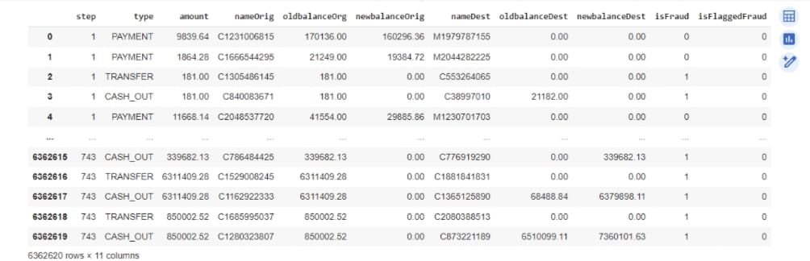
RESULTS
3/21/2024 Annual Review
10

Slide 11
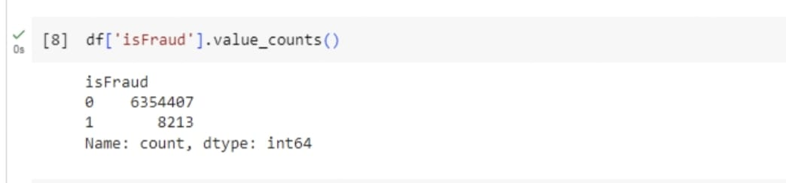
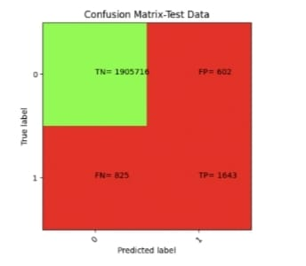

Slide 12
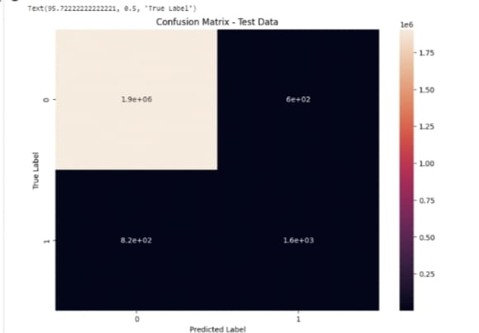
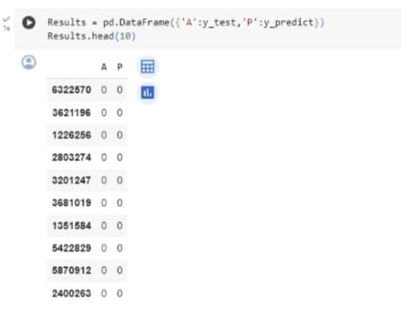

Slide 13
Conclusion
In conclusion, the integration of Generative Adversarial Networks (GANs) into online payment fraud detection systems presents a promising avenue for enhancing security and mitigating financial losses. By leveraging the power of GANs to generate synthetic data that closely resembles real fraudulent transactions, this approach enables the development of more robust and accurate fraud detection models.

